Slide 1
True or False
1
In 2013 a law was past making it illegal to take misletoe into the house of commons, due to the risk it is seen as sexual harassment
FALSE
2
The film White Christmas used asbestos to create the snow
TRUE
Early films also used: white cornflakes, foamite, salt & flour
3
Xmas pudding used to be a soup-like porridge
TRUE
It was called 'frumenty' until 17th century
4
Mistletoe is an ancient symbol of fertility and virility (aphrodisiac)
TRUE
5
During WWII a US card company created packs of cards for Xmas, that when wet revealed escape routes
TRUE
Created in conjunction with American & British Intellligence

Slide 2
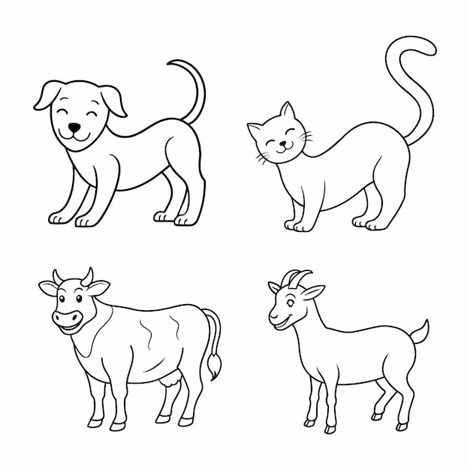
Creatures & Myths
1
The Yule Cat
2
The Yule Goat
In which country are you in danger of being devoured by the Yule Cat at Christmas?
In which country does the invisible spirit Yule Goat appear before Christmas to make sure holiday preparations were done correctly?
ICELAND
SWEDEN, NORWAY, FINLAND,
NORTHERN EURPOEN

Slide 3
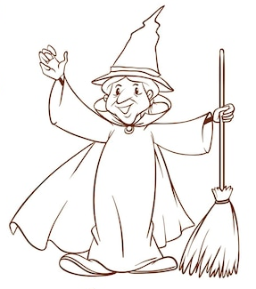
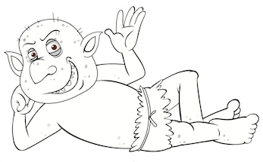
Creatures & Myths
3
Befana
4
Lutins
In which country would you find the Befana (a witch-like old woman) delivering gifts to children on Epiphany Eve (the night of January 5)
In which country would you find these festive hobgoblins?
ITALY, RUSSIA
NORMANDY

Slide 4
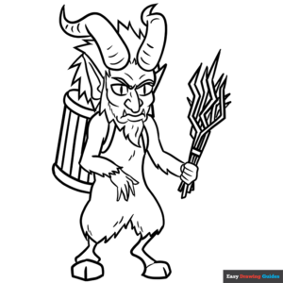
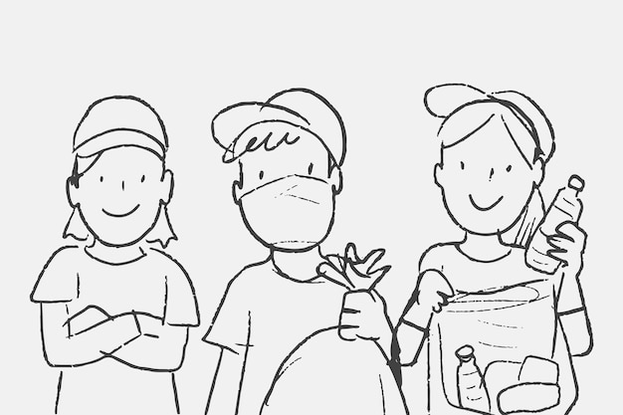
Creatures & Myths
5
Krampus
6
Yule Lads
In which country does Santa’s evil counterpart Krampus punish the naughty children, whilst Santa leaves gifts for the good ones?
In which country would you find the pranksters the Yule Lads?
AUSTRIA
ICELAND

Slide 5
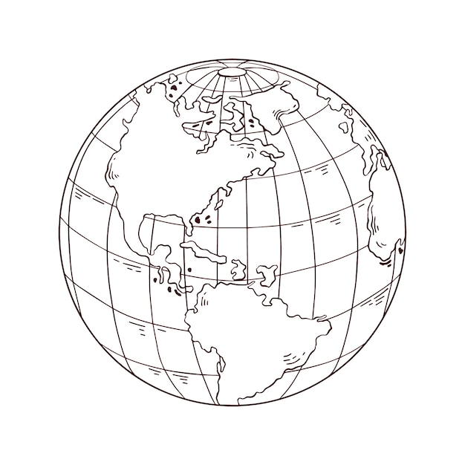

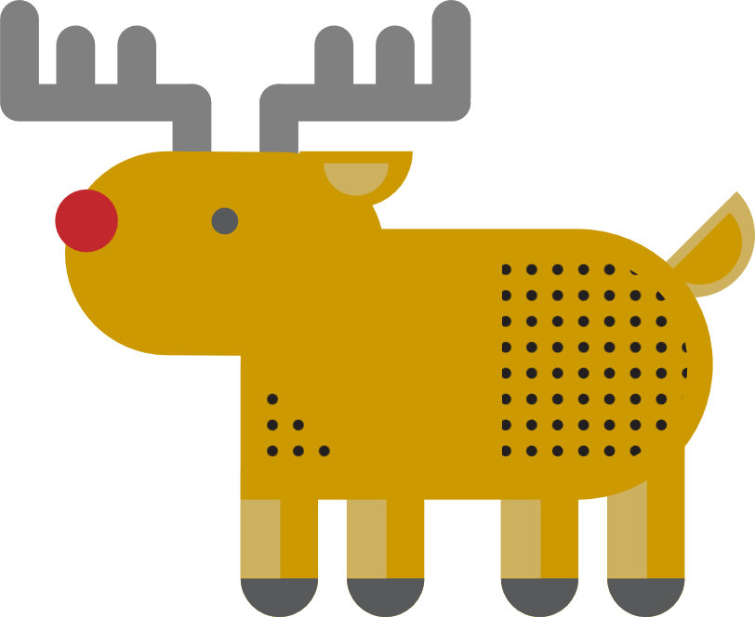



Around the World
Who is the largest exporter of Christmas trees?
Who has the most reindeer?
More than rest of world combined
CANADA
RUSSIA
Who gifts a Christmas tree to Britain, placed in Trafalgar Square, for our help during WW11?
Extra point: since which year?
What is the largest Christmas present in world?
Where is the oldest Christmas Market in Europe
Christkindlemarkt - since 1600s
1886
NORWAY
STATUE OF LIBERTY
NUREMBURG

Slide 6
In Numbers

Slide 7
Music

